Slide 1



Corona Virus Analysis Using SQL
Presented By : Ms. Manya Bajaj

Slide 2

Introduction
The COVID-19 pandemic has had a profound impact globally. This project aims to analyze a COVID-19 dataset using SQL to gain insights into the virus's spread, impact, and recovery trends. By examining geographic data, confirmed cases, deaths, and recoveries, we aim to provide valuable information for better decision-making and strategy development in managing the pandemic.

Slide 3
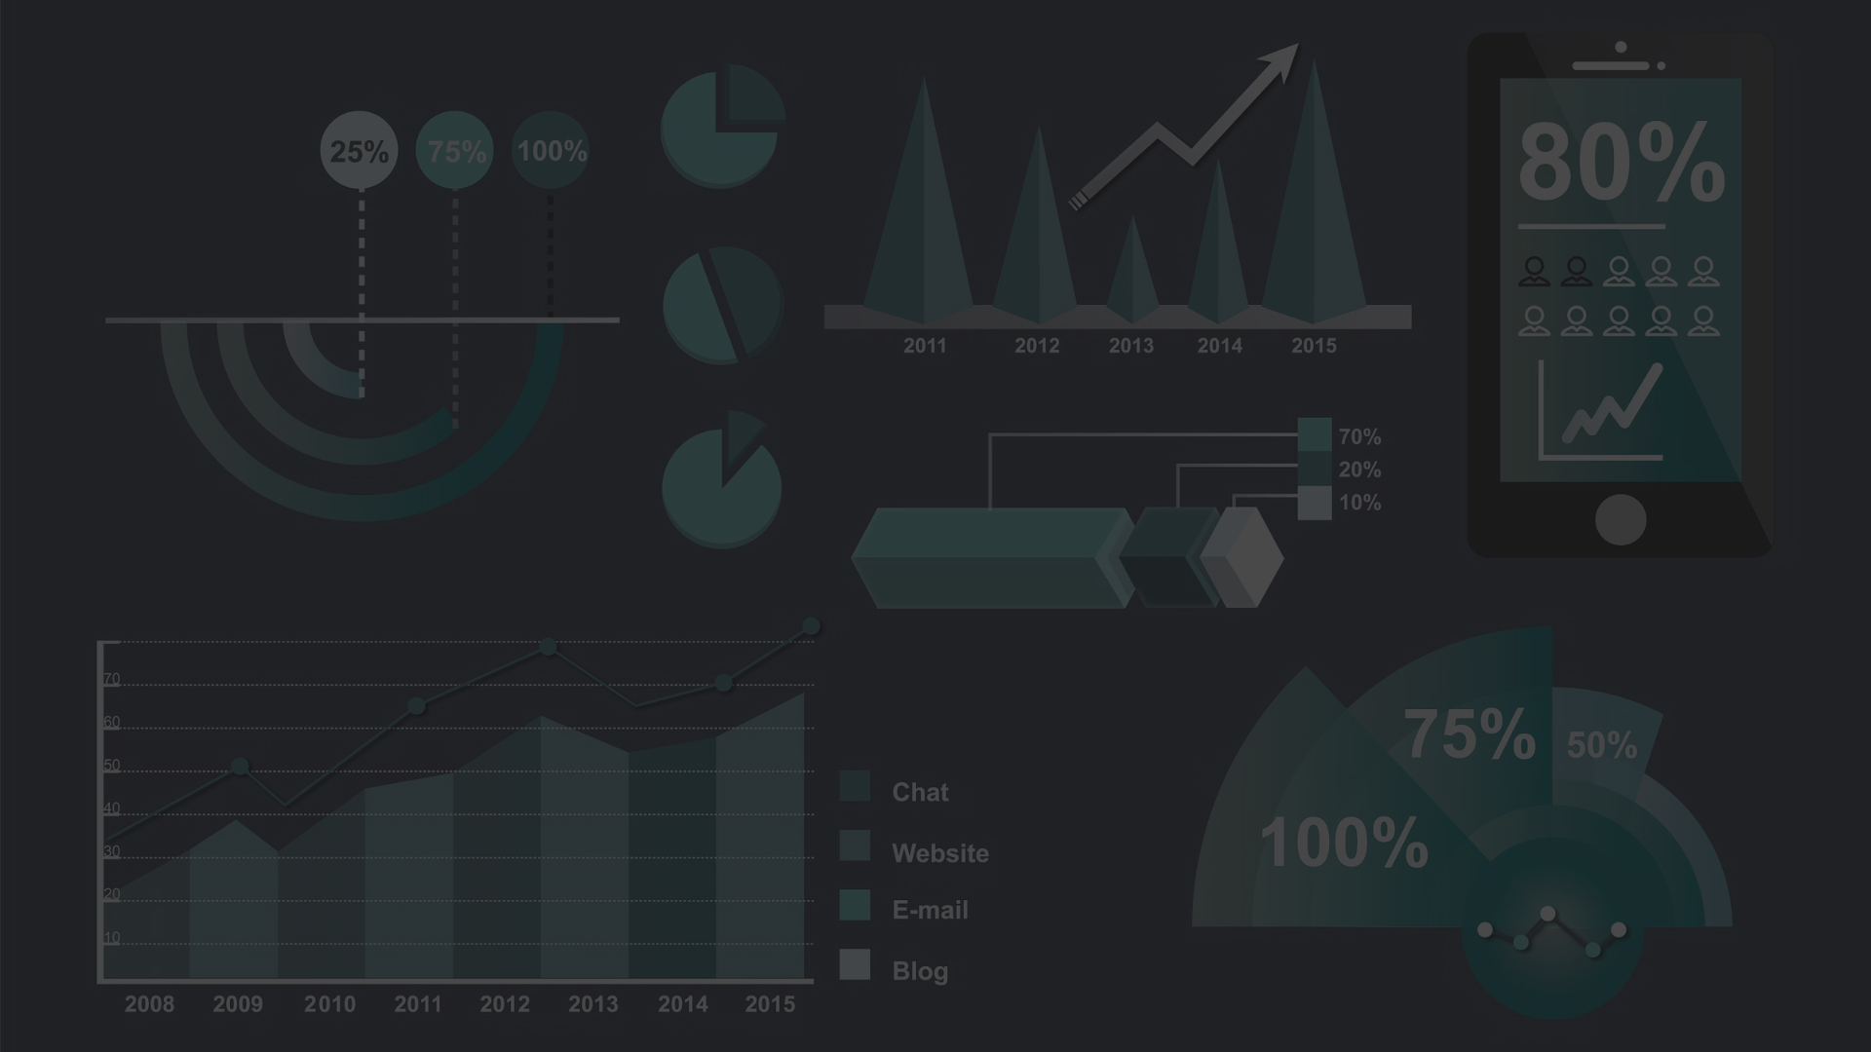
Aim and Objective
1
Aim
2
Objectives
Utilize SQL and data analysis to derive insights from the COVID-19 dataset.
1. Identify patterns in the geographic spread of cases.
2. Evaluate the impact on public health across regions.
3. Provide data-driven recommendations for pandemic management.

Slide 4
How to Add Data in MySQL Workbench
1
Connect to MySQL Workbench
Open MySQL Workbench and connect to your server.
2
Create a Schema
In the Navigator panel, right-click 'Schemas' and select 'Create Schema'. Name your schema and click 'Apply'.
3
Import Data
Right-click the schema name and select 'Table Data Import Wizard'. Browse and select your CSV file. Verify data types and click 'OK' to import.

Slide 5

Conclusion
Key Insights
Data-Driven Approach
This analysis will uncover key trends, assess the effectiveness of public health measures, and offer recommendations for managing COVID-19.
Using SQL and data analysis, this project aims to support efforts in combating the pandemic and preparing for future outbreaks.

